Slide 1
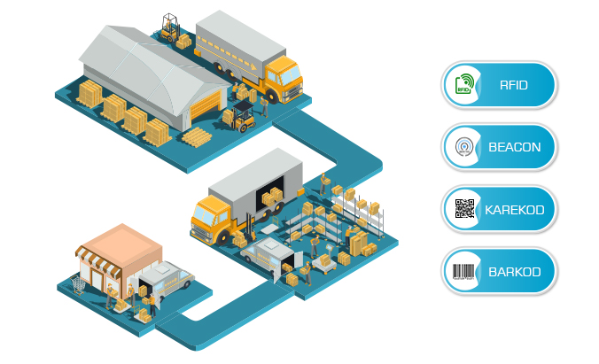
Inventory Management System
Computing Project
ON
By Mahesh Bist
NCC.ID: 00176100

Slide 2
Content
Introduction
Overview of the project
Justification
Aim and objectives
Analysis methodology(waterfall model)
Functional and non functional
MoSCoW
Architecture
Class diagram

Slide 3
Activity diagram
Sequence diagram
Data Flow diagram
ER-diagram
Implementation
Testing
Configuration management.
Conclusion

Slide 4
Introduction
Inventory Management System is all about controlling the product or the stoke of Warehouse that may contain different category. Its like Desktop or Web application through which user can manage the product, sales, category of the products, stocks available in the company as well keep the data about supplier companies. The user of this application can Add, Edit, Delete, and view all the data available in the database.

Slide 5
Overview of project
This project is about managing the stokes or the products available in the Warehouse in easier way.
This system provides records of all users of this system.
We can search the users that are recorded by the system.
The information can be updated and the updated information can be edit, delete as well as view.

Slide 6
Justification of the project
Background of the project
Inventory Management System is Desktop application in where staff or the employee of warehouse can easily manage and control the stock, products and other related record.
This application also contain normal calculator to calculate total sales or to calculate total supplied product.
This desktop application is created through C sharp language and is based on object Oriented.
Problem of the project
In Past, People were unknown about these Management system they used to manage the record the data in some registers by writing every related data with hand which were so time taking.
But, for these automated system the staffs or employee should have some knowledge about computer.

Slide 7
aim and objectives
This system should be able to record the data related to inventory in easier and faster.
Through this system user should be able to search the required data.
The system should have the facility to calculate total of the sold product or related things.

Slide 8
Analysis Methodology (Waterfall)
Inventory Management System contain waterfall Methodology. This is easier method to learn and understand. In Waterfall methodology each steps or the phase should be completed before we move on another step. It move downward like waterfall. It contain following phase which we must complete accordingly.
Requirement analysis
Design
Implementation
Testing
Deployment
Maintenance

Slide 9
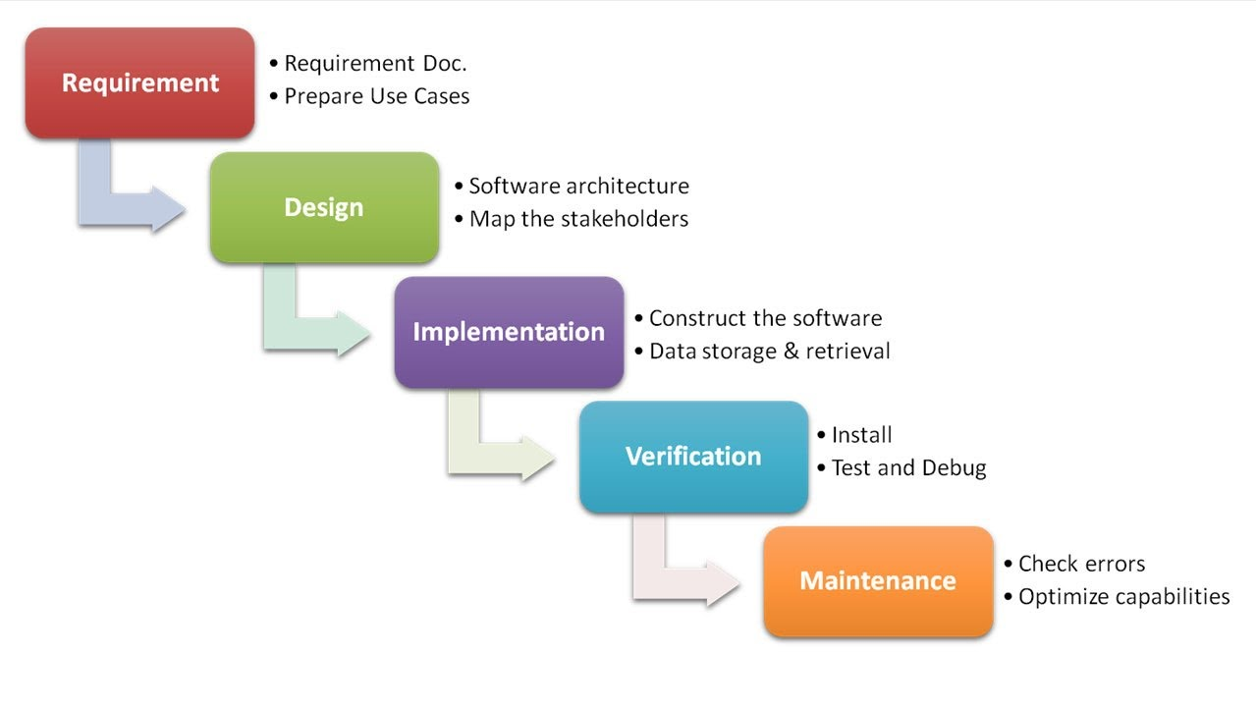

Slide 10
functional Requirement
For Users
Responsive, Mobile Friendly
User should be able to register and login.
System should contain search engine.
View Added record.
Should be able to Update, Edit, Delete, and View data.
Auto calculation can be done in Purchase invoice and sales.
User can connect the database directly through the application through setting.

Slide 11
Non functional requirement
Performance
In this process the speed of the software will be measure to check the efficiency of the Application.
Supportability
This is the process of install, configure and monitor the software in the system. This process also used to find the error and debug in the system.
Security
This is the main requirement which we must apply on the system other wise the important data related to business can be theft through the application. So, this requirement helps to maintain security in the system.
Maintainability
Software should contain beautiful code that helps to keep the software in maintained way. It can be easy for the developer to configure the system and reuse the code.
Usability
Usability is the ease of use and learnability of the system. The developed software should be easier to learn and access.

Slide 12
Moscow
ID | Title | Priority
Functional Requirement
FR01 | Responsive , Mobile Friendly | Should have
FR02 | Registration and login | Must Have
FR03 | search engine | Must Have
FR04 | View Record | Should Have
FR05 | Update, Edit, Delete | Must Have
FR6 | Purchase Invoice and sell | Should have
FR7 | Calculator | Could Have
FR8 | Database Connector | Should have
Non Functional requirement
FR9 | Performance | Should Have
FR10 | Supportability | Could Have
FR11 | Security | Must Have
FR12 | Maintainability | Should have
FR13 | Usability | Could Have

Slide 13
System Architecture
Inventory Management system use 3-tier architecture that have three layer which are Presentation layer, Application layer and database server. Presentation layer contain the PC, Tablet, Mobile, etc. and Application Layer that deals with the server.
The three-tier architecture have following goals:
• The user application and the physical database are separated by the three-tier architecture.
• It helps to support DBMS characteristics.
• Program-data independence.
• It helps to support the multiple data of the system.

Slide 14
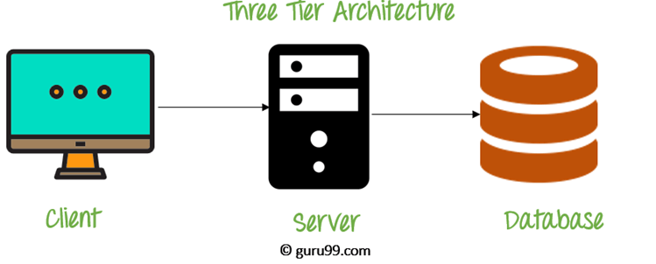
Three-Tier Architecture Diagram

Slide 15
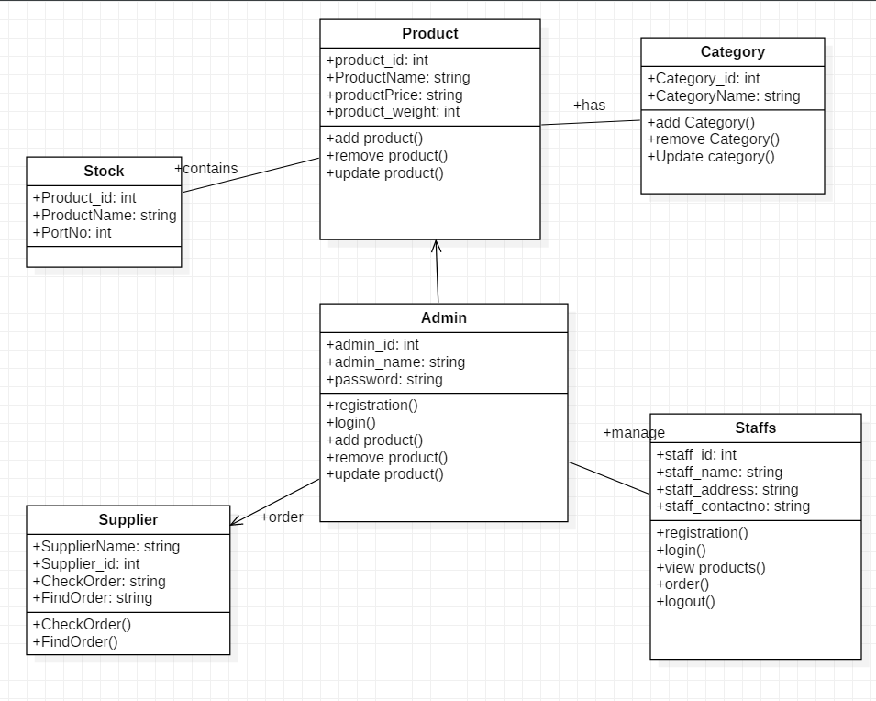
class diagram

Slide 16
Activity Diagram
Activity diagram is also known as the behavioral diagram that describes all the dynamic aspect that contained by the system. It is more advanced then the flow chat diagram. It describe the flow of the system or the flow of activity.
Advantages
It deals with the control flow, it means how the system flow logically.
It will show how the system will behave when it is interacted.
Disadvantages
Activity diagram does not describe in detail, that how the system behave.

Slide 17
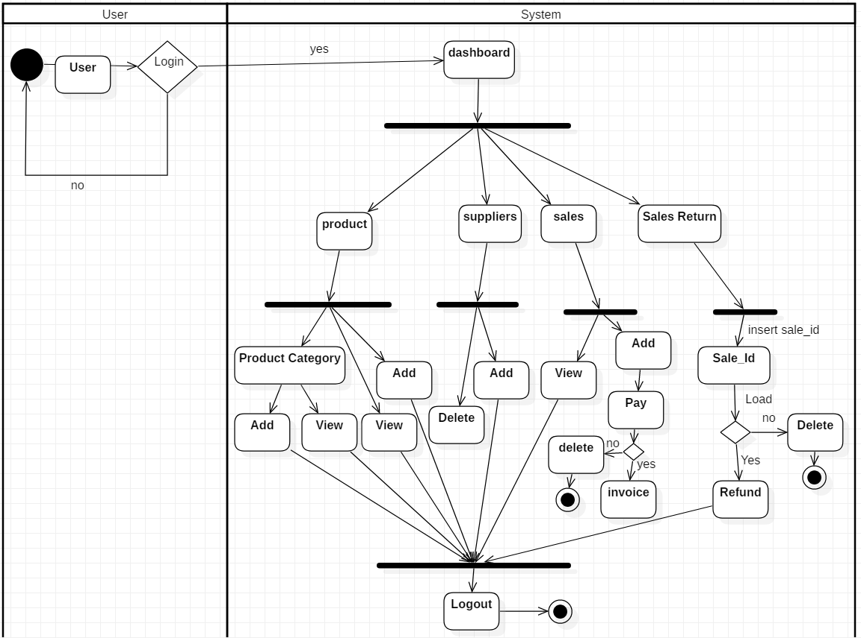

Slide 18
Sequence diagram
A kind dynamic model that arrange the interaction of the object in the time sequence. It helps to show the behavior of different objects. Sequence diagram is also known as event diagram. Name of notation used in this diagram are:
Actor: It will represent the user or admin for my system.
Life line: It represents an individual person in the interaction.
Activation: It will represent the time during which an element is performing an operation.
Call message: It represents the communication between lifelines of an interaction.
Return message: It represents the information back to the user of corresponded former message.

Slide 19
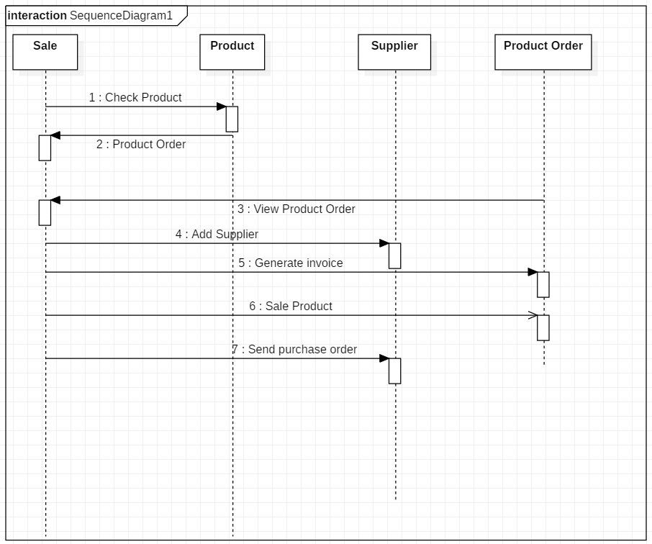

Slide 20
Data Flow Diagram
DFD means the data flow diagram that show the follow of data and information in a certain system and how the system process it in terms of input and output. It really focus on data and information of the certain system where it come and where it go. In the DFD each data store should have minimum one data flow and one data flow must have minimum one output.
Why DFD:
Through data flow Diagram, we can give the overview of the software or the system without going the deep detail of the system.

Slide 21
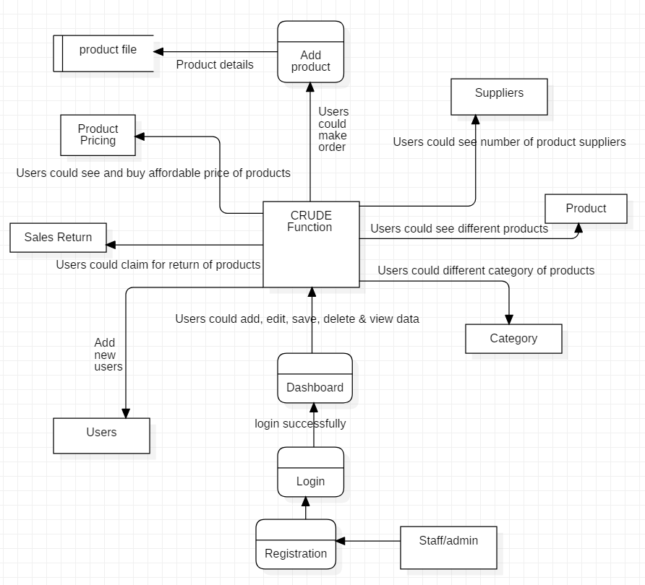

Slide 22
Database modelling (ER-Diagram)
ER diagram is conceptual module and representational module which is used to show the relationship between different classes which are stored in the database. It is more helpful to design the database.
Notation used:
Entity- An entity is a definable object or model within a structure.
Entity Attributes- An attribute is assets of the entity that holds it.
Primary Key- The singular kind of entity features that are store a record in database table which state uniqueness in the table.
Cardinality - Cardinality refers to the uniqueness of data values contained in a column.

Slide 23
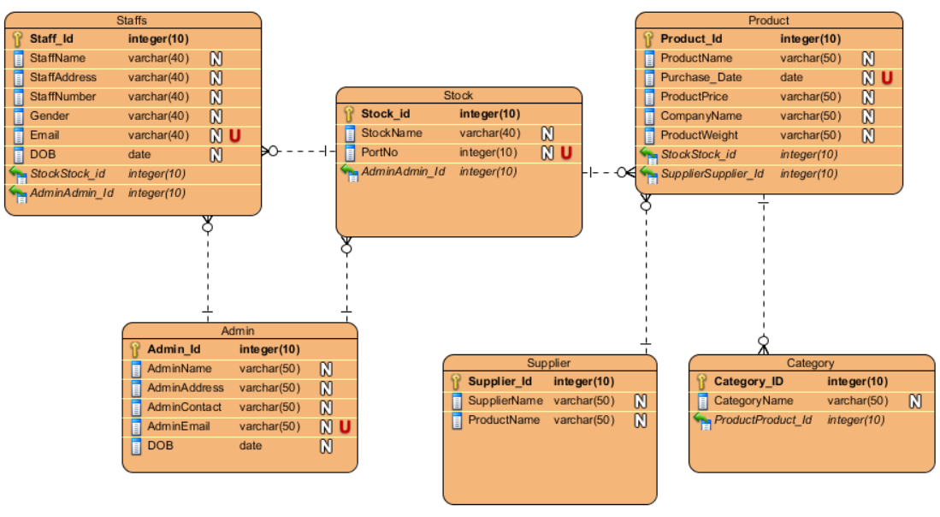

Slide 24
implementation
This is the phase where we used to start Our Coding to develop the system according to our analysis by using the best design approach.
Language Chosen/Framework:
The language that I have choose to develop this application is C sharp. I have developed this Desktop Application by using Visual Studio.
Database Management System:
SQL server is used in this development as a database to store the added or the updated data. So many quarries are used to create different tables and procedure for the application.

Slide 25
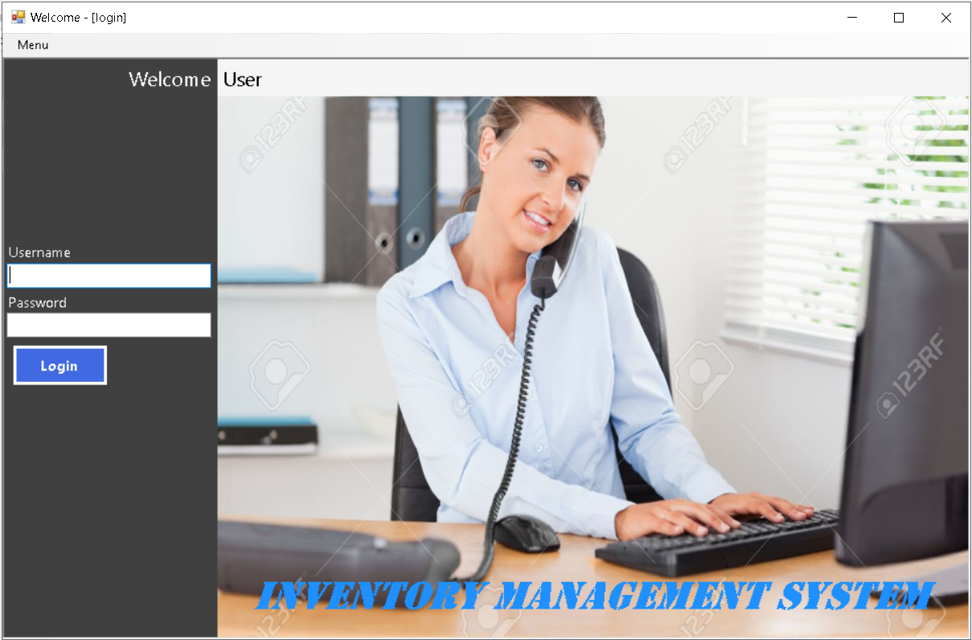
Login page with username “mahesh” and password “mahesh”.

Slide 26
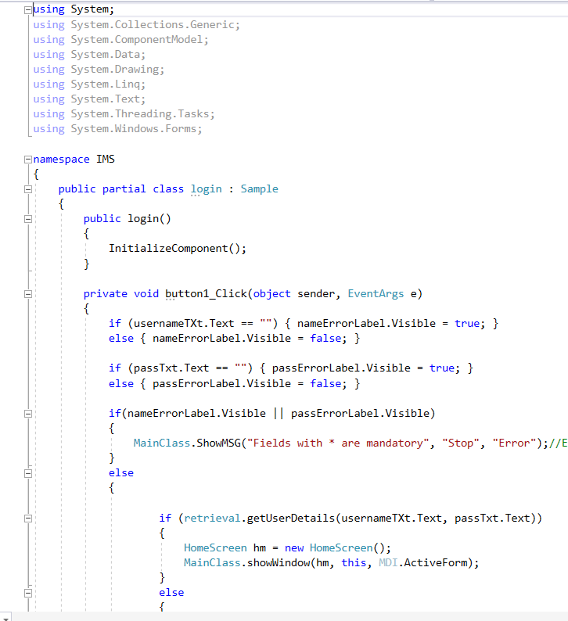

Slide 27
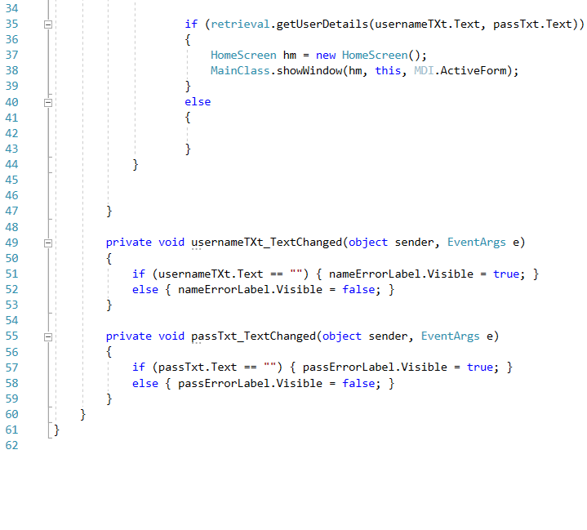

Slide 28
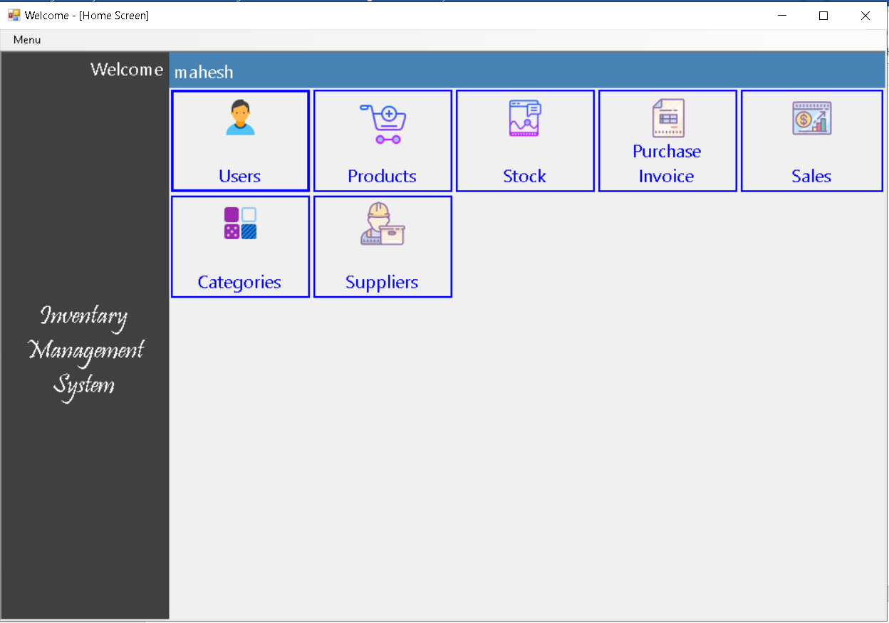
Home Screen

Slide 29
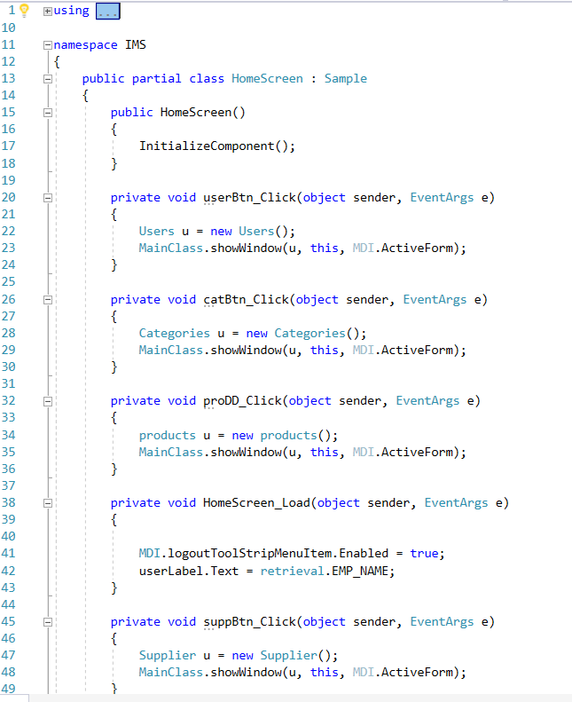

Slide 30
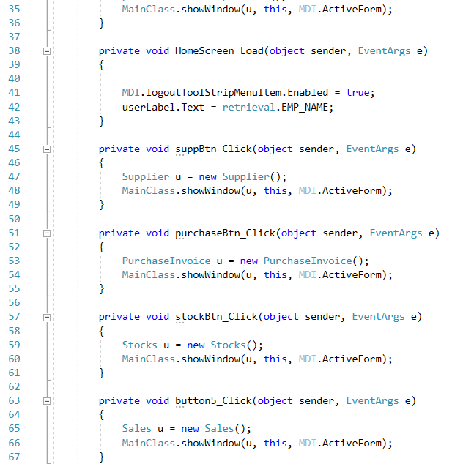

Slide 31
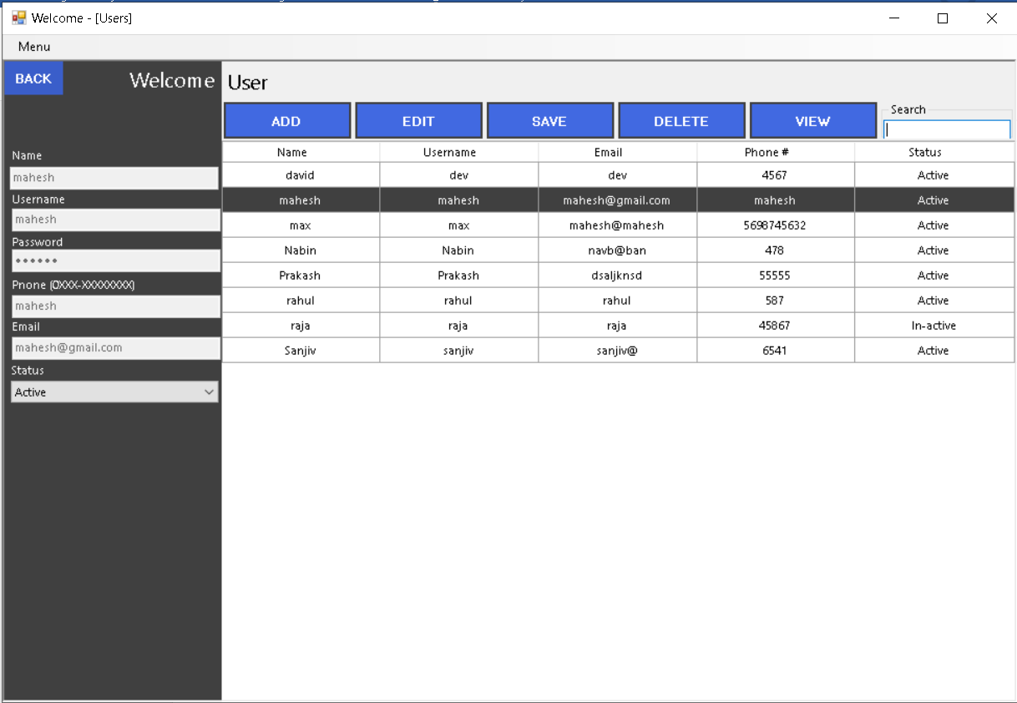
User Interface

Slide 32
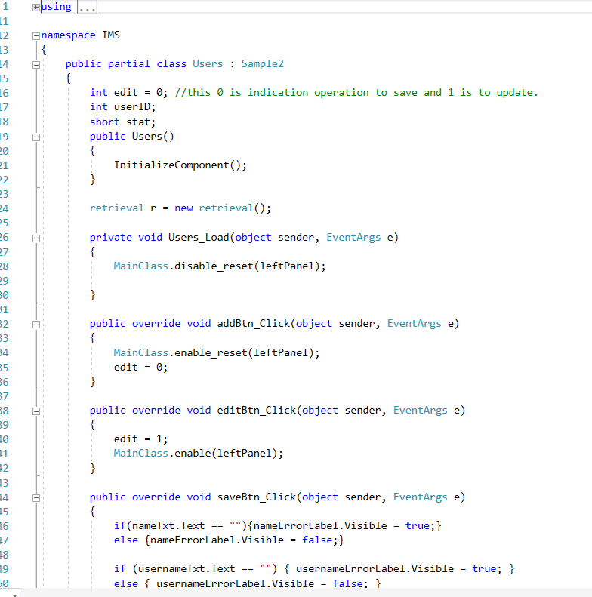

Slide 33
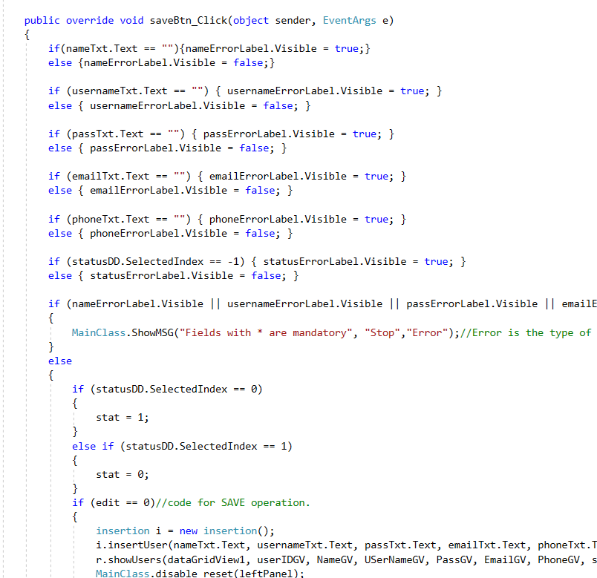

Slide 34
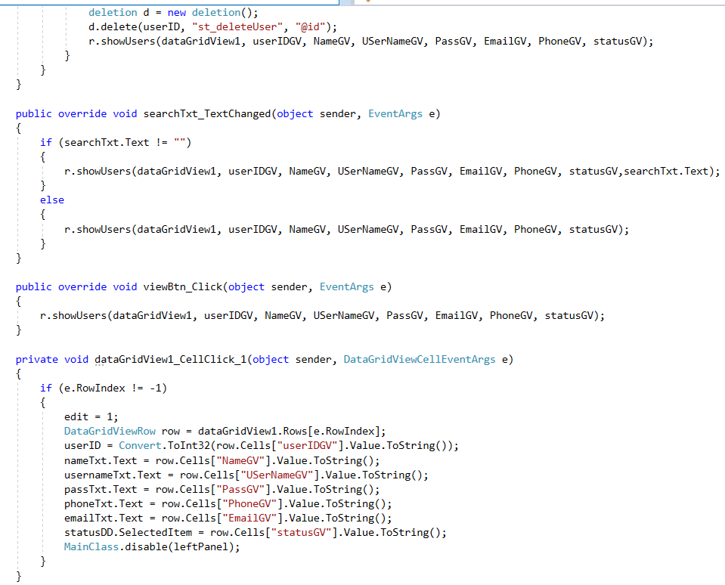

Slide 35
Testing
Testing deals the process where it investigate, evaluate, and ascertain the completion of the software with its complete quality. It helps to identify different errors, gaps as well as missing requirements. Through this process we can make our software durable.
Types:
Black Box Testing
This is the kinds of testing that simply show input and output to show the data are valid and invalid. If result output got pass then it show the Expected result successful otherwise it show fail.

Slide 36
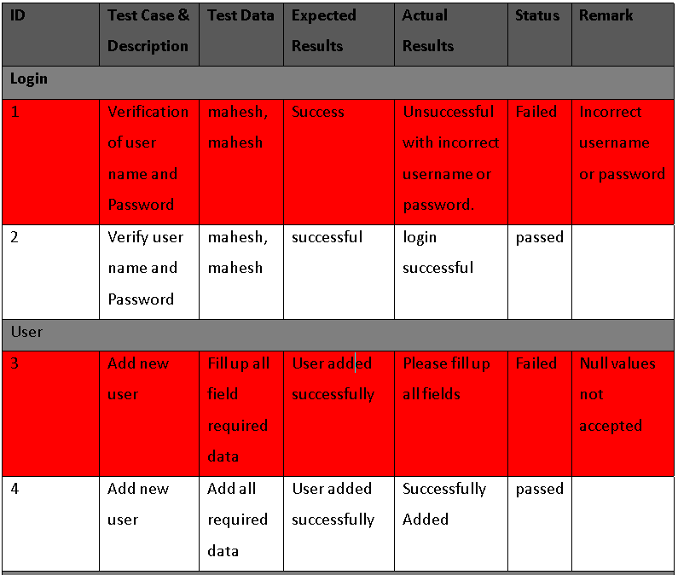
Some Screenshot of Black Box Testing

Slide 37
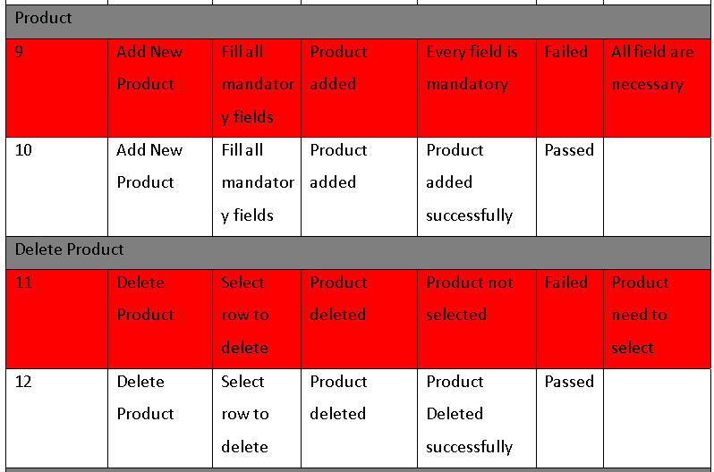

Slide 38
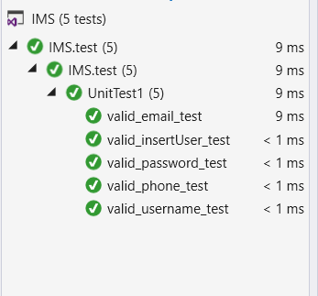
Unit Testing
In this testing individual units or component of the developed software are tested. It helps to know the developer about the unfixed issued and helps to notice and fix them. This testing include the validation testing. It has few input and usually have single output. The smallest unit called method which are the most usable things to test the software.
Screenshot of Successful Unit Testing:

Slide 39
Configuration Management
A configuration is the set of characteristics that define a final product or deliverable. This includes all functional and physical specifications. Physical specifications may include the color, size, weight, shape, and materials.
Five key steps for the configuration management.
Planning should be done to manage record, track and to audit configuration.
All configuration requirement on the project should be identify and recorded.
The configuration must be assessed, approved, and documented. This is normally done with the project change control process.
Project Audit should be done. This include any tests to prove that the product conform to the configuration requirement.

Slide 40
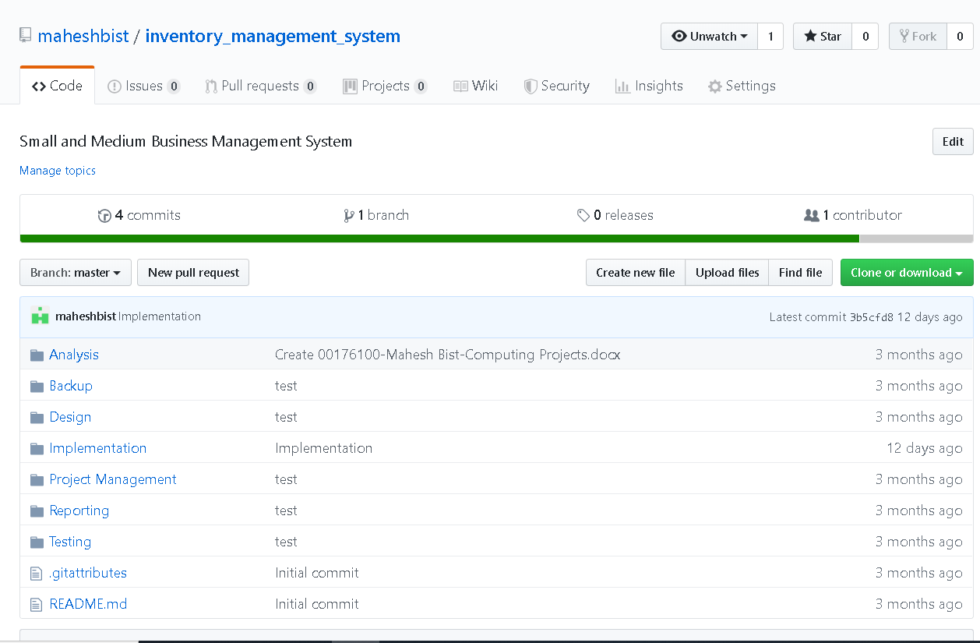
Screenshot of the project data pushed on GitHub.

Slide 41
Conclusion
I conclude an inventory management system is a system designed to help businesses automate their inventory management, whether the inventory is the company’s assets or merchandise.
The development of the project is done under waterfall approach. First the analysis about the project is done to find advantage, disadvantage, and risk with its risk management, after its analysis the design of the project is done in certain date, Then Implementation with its Database design as well as GUI design is done and then finally the Testing part got completed.

